Slide 1

CREDIT CARD FRAUD DETECTION
Machine learning
& data mining
case study

Slide 2
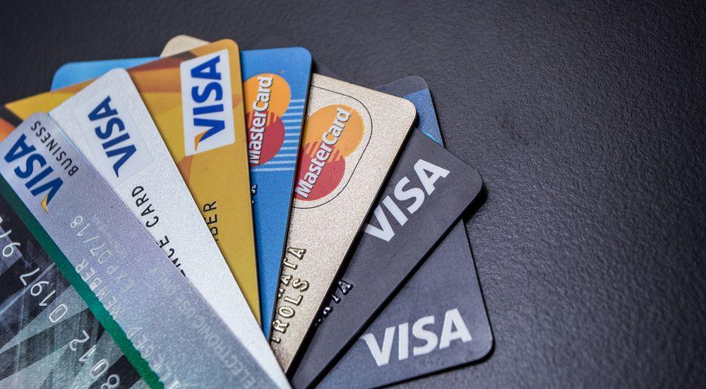
TEAM
Akshaya A - CB.EN.U4CSE17401
Botta Manish Reddy - CB.EN.U4CSE17409
Gayathri E - CB.EN.U4CSE17420
Thejaswagiri P - CB.EN.U4CSE17463
Group number - 9

Slide 3


Problem statement
.
Model is built with the records that turned out to be fraud in the past credit card transactions. The built model is then used to identify whether a new transaction made by the credit card is fraudulent or not.

Slide 4

DATASET
Creditcard.csv
Kaggle Link.
(284807, 31)

Slide 5
Few concepts used
Exploratory data analysis
Logistic regression
Feature selection
Synthetic Minority Oversampling Technique (SMOT)
Random forest

Slide 6
Expected output
To build a model that classifies credit card
transactions as fraud or not, while achieving more accuracy
using various machine learning techniques and algorithms.

Slide 7
Thank you

